Slide 1


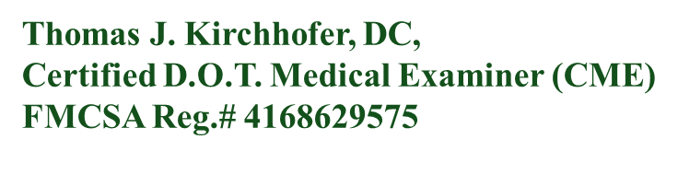
DOT E-Z
A Most Unique Hybrid Practice Possibility

Slide 2
YOU & D.O.T. E-Z
Together, we can change the way commercial drivers experience
their health examinations for the better!

Slide 3
AGENDA
Our Mission
Products and Services
Competitors
Opportunities
Size of Market
Our Numbers
Your Future Path

Slide 4
OUR MISSION
"To maintain a straightforward, self-managed examination process that is digitally controlled by the commercial driver. This system secures appointment slots and supplies the examiner with all necessary information to perform the examination and issue a valid medical certificate. It eliminates the need for administrative staff, and reduces overhead costs, therefore keeping fees affordable."
KEEP THE FEE DOWN BY KEEPING
THE OVERHEAD DOWN!

Slide 5
GENERAL NEED FOR SERVICES
With a network of over 70,000 Certified Medical Examiners, the United States ensures that over 12 million drivers have access to these crucial services.
Most CMEs are practitioners in their specialty fields, fitting drivers between other exams and procedures. This can lead to frustration for drivers who must wait for acute patients to be treated before they can be seen.
Occupational Medicine chains like Premise Health, Concentra, Workwell, Occucare International, and others cater to large transportation corporations. They offer various services for work injuries, stress-related illnesses, and industry-specific acute and chronic conditions.
Drivers from large companies are often sent to these chains but sometimes choose to personally pay an independent CME like us to avoid that environment.

Slide 6
Competitors
Who needs us?
The secret is to treat them fairly
INCOME IS CASH OR CARD!
There is an increasing demand for more facilities to serve commercial drivers. The U.S. Department of Transportation requires that only licensed professionals such as MDs, DOs, NP-Cs, PAs, and DCs can conduct these examinations. Drivers are opting for smaller facilities that offer scheduled visits over walk-ins, avoiding the need to compete for earlier arrival times and reducing wait times.
Drivers appreciate being treated as individuals, not just another number. As a result, they tend to return to places where they received the best treatment, found it most convenient, and the price was fair.
Depending on their health history, drivers receive a medical card valid for up to 24 months, or less if health issues are present. Nearly 100% of our income comes from cash or credit card payments, as health insurance is not applicable since this is not an illness and no diagnosis is involved. A small number of accounts are paid monthly, typically within two weeks of receiving an emailed invoice.
Medical cards are required for 12 million drivers.
Thousands live in our surrounding community.
Multiple trucking companies domiciled here.
Serving small to mid-sized companies.
D.O.T. E-Z is the only full-time facility in our area dedicated solely to exams and screenings for commercial drivers. Unlike others, we don’t shuffle drivers between administrative assistants, nurses, and doctors. Our process ensures a seamless experience from start to finish. Drivers select their appointment day and time, guaranteeing their time is respected. Every test is conducted by a licensed professional who signs their medical card, providing a decision at the end of the examination.

Slide 7
OPPORTUNITIES
PRIME MARKET GOAL | REMAIN AS THE ONLY FULL TIME CME PRACTICE!
Demographics | The name D.O.T. E-Z might have seemed elementary at first, but "DOT" is the first term in everyone's Google search. When the search includes our location, we stand out! Competitors start with terms like "affordable" or "walk-in," while others use "cheapest" or "free." These all tend to take a back seat to our strategically chosen name.
Personalization | Word of Mouth—When clients receive exceptional service, they feel compelled to share their experience. Commercial drivers often spread the word through CB radios, reaching a wide audience. We make a concerted effort to be friendly and engage in conversations about their family and job conditions. When clients rate us on Google, we respond with a personal thank you. We return all calls for assistance, day or night. Repeat business accounts for 50% of our gross income.
Emerging Content Niches | As we grew, we consistently worked to keep our overhead low, ensuring our fees remained competitive. Our user-friendly calendar allows clients to easily select their preferred appointment day and time, then redirects them to a page where they can complete their health history and sign their name. Upon arrival at the facility, everything is prepared, and there are no delays. The medical card is printed and presented in a unique carrying envelope for their wallet. Notably, 80% of the administrative work is handled via computer without the need for operator assistance!
Promising Growth Events | Kennesaw, GA, is booming with development, boasting 49 new condo, townhouse, and apartment communities, adding thousands of units to accommodate a growing population. Currently home to 35,122 residents, the city also hosts Kennesaw State University (KSU), a thriving Division I institution with 35,600 students across two major campuses. Our former municipal airport, KRYY, has transformed into Cobb County International, experiencing increasing monthly traffic, with numerous corporate jets and a small airline now operating there. Growth is evident everywhere!

Slide 8

SIZE OF THE MARKET
12 Million Drivers
12 MILLION DRIVERS
In the U.S. there are an estimated 12 million commercial drivers with CDL or Non-CDL license who qualify to need a D.O.T. Medical Card
5,000+ Private Drivers examined
5000 PRIVATE DRIVERS
D.O.T. E-Z has examined over 5,000 individual drivers, many of whom are private drivers with their own businesses or employees of small companies. Many of these drivers have been examined multiple times and will continue to do so for years. This number is set to grow exponentially.
278 COMPANY CLIENTS
Beginning with one client company in 2014, more were referred to D.O.T. E-Z. New companies steadily continue to come on board. As word-of-mouth referrals continue, population growth, along with online shopping, continues to increase the need for more drivers for delivery from multiple retail markets.
278 Company clients

Slide 9

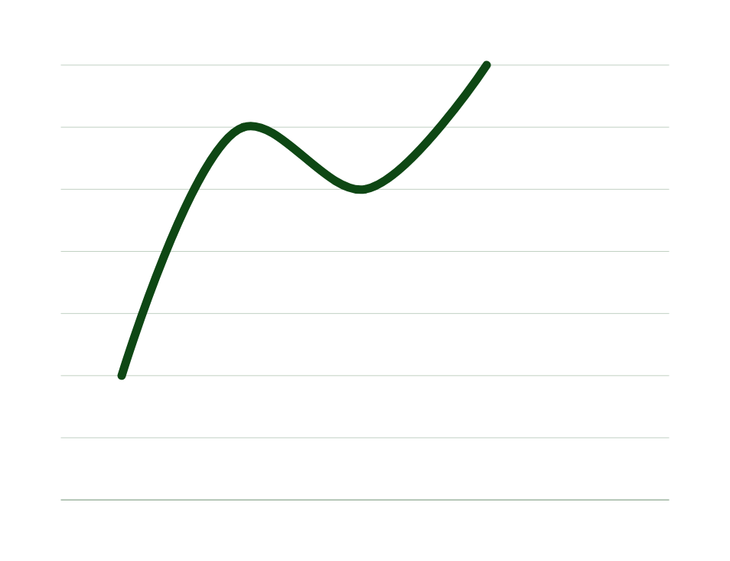
June 2014 Certified to begin D.O.T. E-Z
December 2016, end of the first calendar year.
Pre-and post-pandemic years:
December 2021 $79,000
December 2022 $83,000*
December 2023 $67,000**
*This 2022 income includes $20,000 from a second source, including drug screening
**The 2023 decrease is attributed to a strategic decision to reduce drug screening activities, allocating more hours to higher profitability tasks or services. However, the most recent income, not yet shown, will include from this company was still $555.00 for the month of October 2024. The experiment is working!

Slide 10
What Drives Our Numbers -
During the post-pandemic period, we saw a rise in income from drug screenings and other services provided to a large company at a discount. This company, eScreen Labs owned by Abbott Labs, had an outdated contract with us for discounted fees that was no longer profitable. We negotiated a new fee that placed D.O.T. E-Z outside of their regular fee structure and removed us from their standard referral system, allowing us to provide services as needed. While we initially saw a $16,000 drop in income, this change opened the door for increased activity at a more profitable scale, now controlled by D.O.T. E-Z.
FUTURE GROWTH
CONTRACTS
To date, our income from FedEx has solely come from FedEx Ground contractors and their employed drivers. Currently, the Kennesaw operation is merging FedEx Express drivers with FedEx Ground drivers under the leadership of the Ground Contractors. While the final plans and number of drivers are yet to be determined, we anticipate a significant increase in 2025.
CURRENT
eScreen, owned by Abbott Labs, provides us with software and tools for collecting drug screens via urine or hair follicle samples. This system operates in two ways: we collect samples for our clients, charge a $40.00 fee, and pay eScreen for processing, making a $25.00 profit. Additionally, eScreen pays us $70.00 for referred drivers' DOT medical exams under their control.
DOT E-Z holds two key contracts that can transfer to a new owner. One is as a FedEx Ground Vendor. This arrangement, managed through a third-party administrator called First Advantage. They compensate us separately for every new driver hired at the Marietta Terminal.

Slide 11
YOUR FUTURE PATH
Why Sell?
What are we selling?
Price of this offer and Valuation
It Pays You to Own
Dr. Tom Kirchhofer has been in business for himself since the age of 12. A determined goal-setter, he has always strived to achieve his vision of success. D.O.T. E-Z was founded at the end of his 34-year career as a chiropractor. Now in its 11th year of CME certification, Dr. Tom, at 82 years old, is ready to pass on his legacy
D.O.T. E-Z is unique as an ongoing business because we have become the “go-to place” for drivers in need of our services. They must have a valid medical card to drive, which expires periodically and needs renewal. We offer low-cost services and make the process easy and accessible for drivers. We pride ourselves on exceeding expectations. Our approach is transferrable!
When you purchase this business, it is a “turnkey” operation that includes lease transfers and all equipment, including any current inventory, desks, chairs, computers, and software programs. Dr. Kirchhofer will guide you through the transition, ensuring you're fully prepared for ownership.
Unlike buying a franchise, there’s no setup time or additional purchases required before you start. The moment you step into the business, fees will be processed to your designated account! Based on past performance, you can expect to earn between $1,000 and $1,460 per week without implementing any new procedures.
The initial purchase cost of $400,000 is an investment to own the facility and the business activity with unlimited growth potential for someone with the ideas and energy to follow their dream. Expansion of hours and days, advertising, and changes in location are all possibilities, provided the cost/value ratio remains favorable.
Remaining within the healthcare industry makes this purchase attractive to commercial financiers and eligible for support from the Small Business Administration (SBA).
The additional licensing to your specialty is negligible as a certification lasting 10 years.

Slide 12

Thank you.
QUESTIONS AND CONVERSATION WELCOMED:
DR TOM KIRCHHOFER
3166 CHEROKEE ST., NW
BOX 11
SUITE 102 D
KENNESAW, GA 30144
PH: (770) 635-7015 EXT 2
FAX: (770) 763-8169
EMAIL: DRTOM.KIRCHHOFER@GMAIL.COM

